Slide 1

Winter 2017-18
School of Mechanical and Building Sciences
MEE 1002 Engineering Mechanics
Module 6
Dynamics-Kinematics
By
Dr. S.JEYANTHI

Slide 2
Outline
Rectilinear Motion
Curvilinear Motion

Slide 3
Rectilinear Motion

Slide 4
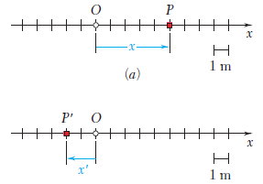
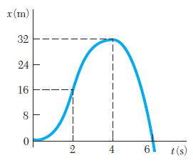
Rectilinear Motion
A particle moving along a straight line is said to be in rectilinear motion.
Position
The distance x, with the appropriate sign, completely defines the position of the particle.
When the position coordinate x of a particle is known for every value of time t, we say that the motion of the particle is known.

Slide 5




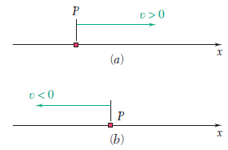
Velocity
A positive value of v indicates that x increases, i.e., that the particle moves in the positive direction.
A negative value of v indicates that x decreases, i.e., that the particle moves in the negative direction.
The magnitude of v is known as the speed of the particle.

Slide 6






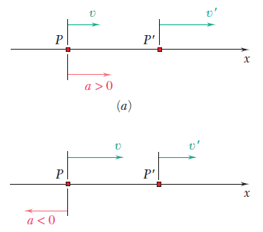
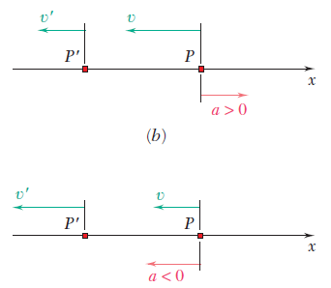
Acceleration

Slide 7


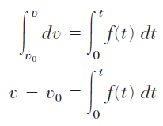

Motion of a Particle-If a is variable
1) a=f(t)
Upon integration, we get v-t relationship
Upon integration, we get x-t relationship

Slide 8

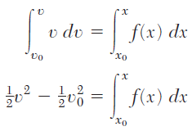


2) a=f(x)
Upon integration, we get x-t relationship

Slide 9
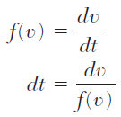
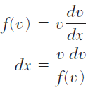
3) a=f(v)
Upon integration, we get v-t relationship
Upon integration, we get x-t relationship

Slide 10

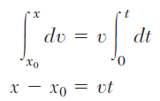

Uniform Rectilinear Motion

Slide 11


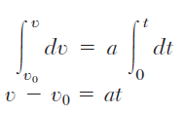


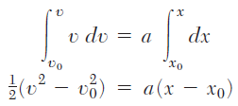

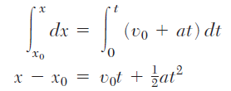

Uniformly Accelerated Motion

Slide 12



Relative Motion-Independent Motion

Slide 13
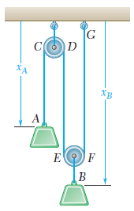
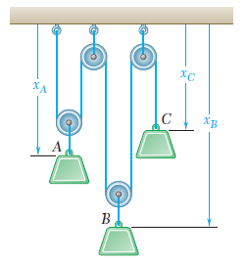

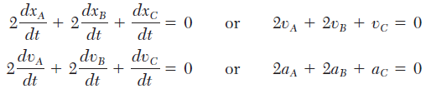
Relative Motion-Dependent Motion

Slide 14
Problems
Differential Equations of Motion
Integral Equations of Motion
Uniformly Accelerated Motion
Bodies Thrown Upwards/Dropped
Relative Velocity
Independent Motion
Dependent Motion

Slide 15
Differential Equations of Motion-Problem-1
The position of a particle which moves along a straight line is defined by the relation x = t³ - 6t² - 15t + 40, where x is expressed in feet and t in seconds. Determine,
(a) the time at which the velocity will be zero,
(b) the position and distance travelled by the particle at that time,
(c) the acceleration of the particle at that time,
(d) the distance travelled by the particle from t = 4 s to t = 6 s.

Slide 16
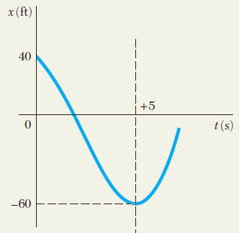
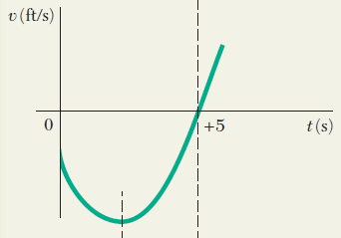
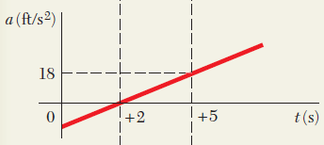

Slide 17
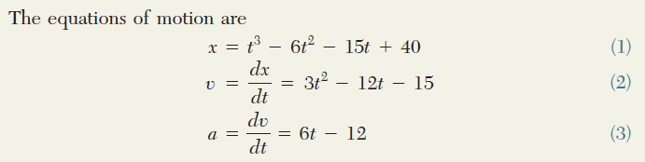

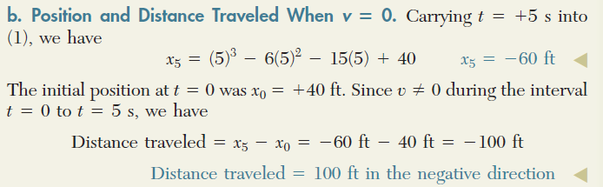

Slide 18
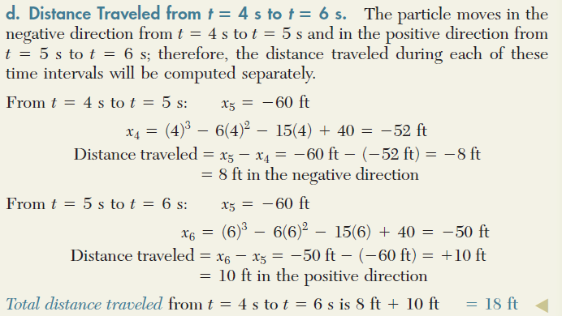

Slide 19
Differential Equations of Motion-Problem-2
The position of a particle in rectilinear motion is defined by the relation x = t³ - 2t² + 10t - 6, where x is expressed in metres and t in seconds. Determine,
(a) the position, velocity and acceleration at t=3 s
(b) the average velocity during t=2 s and t=3 s
(c) the average acceleration during t = 2 s and t = 3 s.

Slide 20
Integral Equations of Motion-Problem-1
The acceleration of a particle in rectilinear motion is defined by the relation a=kt. The velocities of the particle at times t=1 s and t=2 s are respectively v=2 m/s and v=3 m/s. write the equations of motion given that x=0 at t=3 s.

Slide 21
Integral Equations of Motion-Problem-2
The rectilinear motion of a particle is governed by a=-16/x³, where ‘a’ is in m/s² and x is in metres. Given that at time t=1 s, x=2 m and v=2 m/s, (i) write the equations of motion (ii) determine the position, velocity and acceleration at t=4 s.

Slide 22
Uniformly Accelerated Motion-Problem-1
A train starting from rest attains a maximum speed of 54km/h in 30 s with uniform acceleration, it then travel with this speed for 40 s and is then brought to rest in further 30 s with uniform retardation, calculate the total distance travelled.

Slide 23
A train starting from rest attains a maximum speed of 54km/h = 54 × 5/18 = 15 m/s with uniform acceleration.
use formula, v = u + at
here, u = 0, v = 15m/s , t = 30s
so, 15 = 0 + 30a => a = 0.5 m/s²
so, distance covered during motion , S = ut + 1/2at²
= 0 + 1/2 × 0.5 × (30)² = 225 m

Slide 24
then, train with maximum speed 54km/h or 15m/s for 40s.
so, distance covered during this motion , S' = vt
= 15 × 40 = 600m
now, train is brought to rest further 30sec with uniform retardation . so, retardation = -0.5 m/s² [ magnitude of retardation is same acceleration this is due to time taken during motion is same.]
so, distance covered , S" = ut + 1/2at²
S" = 15 × 30 - 1/2 × 0.5 × (30)²
= 450 - 225 =225
hence, total distance covered by train = 225 + 600 + 225 = 1050m

Slide 26
Uniformly Accelerated Motion-Problem-2
The speed of a truck moving at a constant speed of 30 m/s is reduced to 20 m/s in a distance of 200 m. Determine, (i) the acceleration assuming it to be constant and (ii) the time taken. Also, determine the distance in which the truck can be brought to a stop with the constant acceleration calculated.
a = -1.25 m/s² (Deceleration)
t = 8 sec
x = 160 m

Slide 27
Uniformly Accelerated Motion-Problem-3
A car covers 100 m in 10 seconds, while accelerating uniformly at a rate of 1 m/s². Determine, (i) initial and final velocities of the car (ii) distance travelled before coming to this point assuming it started from rest, and (iii) its velocity after the next 10 seconds.
v_{o} = 5 m/s and v = 15 m/s
x = 12.5 m
v = 25 m/s

Slide 28
Uniformly Accelerated Motion-Problem-4
The driver of a car moving at a constant speed of 18 kmph realizes that if he moves at this speed, he will reach the office late by 10 seconds. Hence, he accelerates at a constant rate of 2 m/s² so that he reaches the office right in time. Determine the time taken to reach the office and the distance covered during this time.
t = 7.07 sec
x = 85.33 m

Slide 29
Bodies Thrown Upwards/Dropped-Problem-1
A ball is tossed with a velocity of 10 m/s directed vertically upward from a window located 20 m above the ground. Knowing that the acceleration of the ball is constant and equal to 9.81 m/s² downward, determine,
(a) The velocity v and elevation y of the ball above the ground at any time t,
(b) the highest elevation reached by the ball and the corresponding value of t,
(c) the time when the ball will hit the ground and the corresponding velocity.
Draw the v−t and y−t curves.

Slide 30
Bodies Thrown Upwards/Dropped-Problem-2
A ball is thrown vertically upwards from the ground. Two men standing at different heights on a building watch the ball pass by them at speeds of 20 m/s and 10 m/s respectively. Determine the height between their locations. How high does it rise beyond the second man?

Slide 31
Relative Motion (Independent Motion) Problem-1
A man standing at a bus stand sees that a bus just leaves when he is about 20 m from the bus. If the bus accelerates at a constant rate of 1 m/s² then determine the acceleration with which the man must run to catch the bus within a distance of 30 m. Also, determine the speeds of the bus and the man at that instant.

Slide 32
Relative Motion (Independent Motion) Problem-2
At the intersection, when the traffic signal turns green, a car starts with a constant acceleration of 3 m/s². At the same instant, a bus travelling in the adjacent lane crosses the signal overtaking the car at a uniform speed of 36 kmph. Determine when and where the car will overtake the bus. Also, determine the speed of the car at that instant.

Slide 33
Relative Motion (Independent Motion) Problem-3
In a car race, the car A starts and accelerates at a constant rate of 3 m/s² . Car B starts 2 seconds later but accelerates at a constant rate of 4.6 m/s². Determine, (i) when and where the car B will overtake A, and (ii) speed of the two cars at that instant.

Slide 34
Relative Motion (Independent Motion) Problem-4
A ball is thrown vertically upward from the 12-m level in an elevator shaft with an initial velocity of 18 m/s. At the same instant an open-platform elevator passes the 5-m level, moving upward with a constant velocity of 2 m/s. Determine
when and where the ball will hit the elevator,
the relative velocity of the ball with respect to the elevator when the ball hits the elevator.

Slide 35
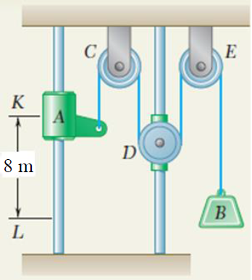
Relative Motion (Dependent Motion) Problem-1
Collar A and block B are connected by a cable passing over three pulleys C, D, and E as shown. Pulleys C and E are fixed, while D is attached to a collar which is pulled downward with a constant velocity of 3 m/s. At t = 0, collar A starts moving downward from position K with a constant acceleration and no initial velocity. Knowing that the velocity of collar A is 12 m/s as it passes through point L, determine the change in elevation, the velocity, and the acceleration of block B when collar A passes through L.

Slide 36
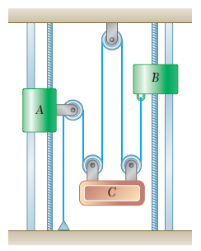
Relative Motion (Dependent Motion) Problem-2
Collar A starts from rest at t = 0 and moves downward with a constant acceleration of 7 m/s². Collar B moves upward with a constant acceleration, and its initial velocity is 8 m/s. Knowing that collar B moves through 20 m between t = 0 and t = 2 s, determine (a) the accelerations of collar B and block C, (b) the time at which the velocity of block C is zero, (c) the distance through which block C will have moved at that time.

Slide 37
Curvilinear Motion

Slide 38
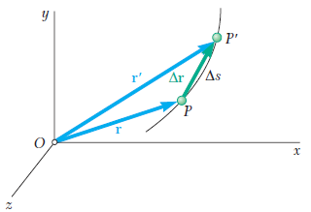

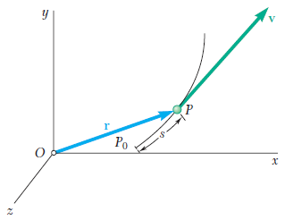
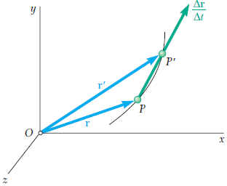



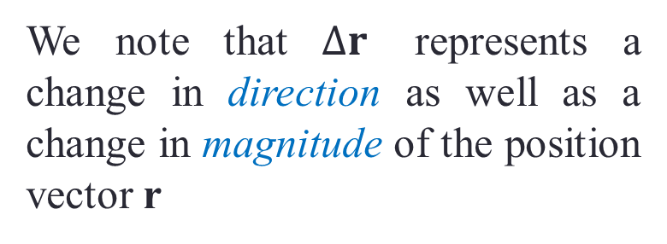
Position, Velocity and Acceleration
We note that $∆r$ represents a change in direction as well as a change in magnitude of the position vector r

Slide 39
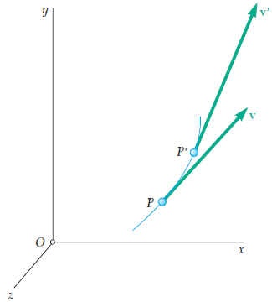
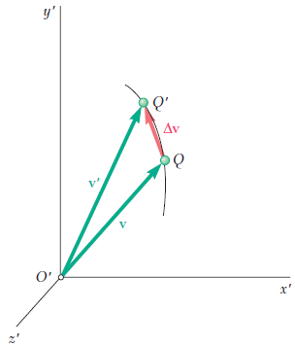
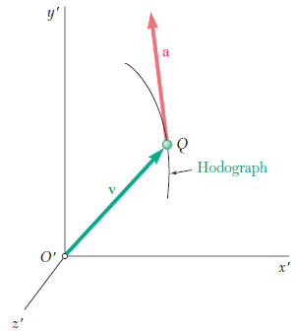
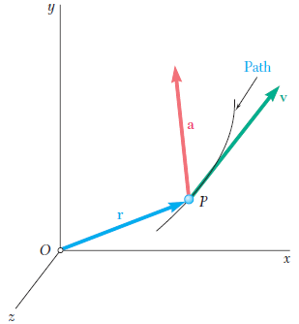


Position, Velocity and Acceleration

Slide 40
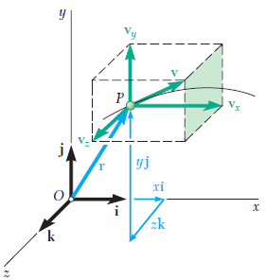

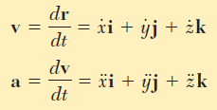
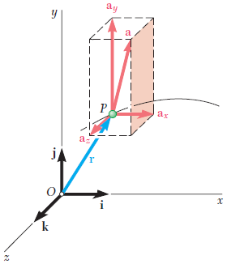

Rectangular Components

Slide 41
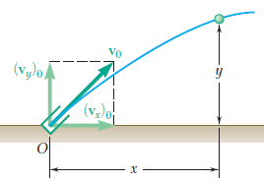

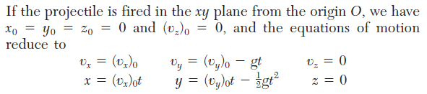
Motion of a Projectile

Slide 42
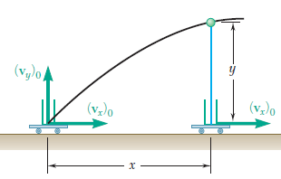
These equations show that the projectile remains in the x-y plane
Its motion in the horizontal direction is uniform
Its motion in the vertical direction is uniformly accelerated
The motion of a projectile can thus be replaced by two independent rectilinear motions.

Slide 43
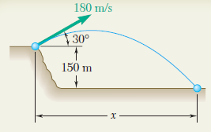
Problem-1
A projectile is fired from the edge of a 150-m cliff with an initial velocity of 180 m/s at an angle of 30° with the horizontal. Neglecting air resistance, find
the horizontal distance from the gun to the point where the projectile strikes the ground,
the greatest elevation above the ground reached by the projectile.

Slide 44
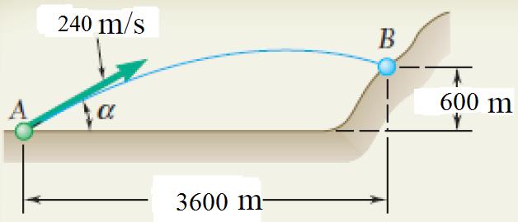
Problem-2
A projectile is fired with an initial velocity of 240 m/s at a target B located 600 m above the gun A and at a horizontal distance of 3600 m. Neglecting air resistance, determine the value of the firing angle α.
α = 29.9° and α = 69.6°

Slide 45
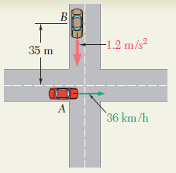
Problem-3
Automobile A is traveling east at the constant speed of 36 km/h. As automobile A crosses the intersection shown, automobile B starts from rest 35 m north of the intersection and moves south with a constant acceleration of 1.2 m/s². Determine the position, velocity, and acceleration of B relative to A 5 s after A crosses the intersection.

Slide 46
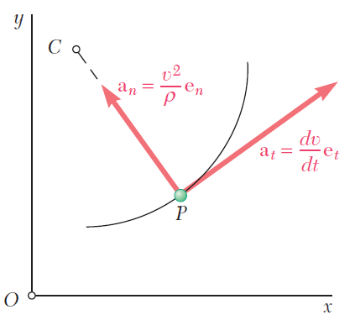


Tangential and Normal Components of Acceleration

Slide 47
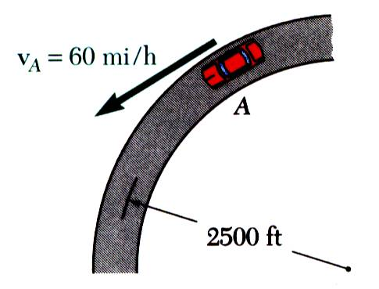
Sample Problem
A motorist is traveling on curved section of highway at 60 mph. The motorist applies brakes causing a constant deceleration rate. Knowing that after 8 s the speed has been reduced to 45 mph, determine the acceleration of the automobile immediately after the brakes are applied.
SOLUTION:
Calculate tangential and normal components of acceleration.
Determine acceleration magnitude and direction with respect to tangent to curve.

Slide 48
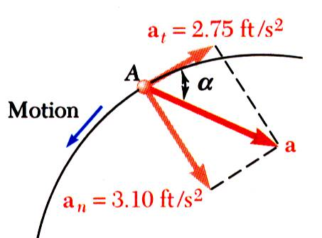
SOLUTION:
Calculate tangential and normal components of acceleration.
Determine acceleration magnitude and direction with respect to tangent to curve.

Slide 49
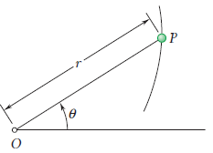
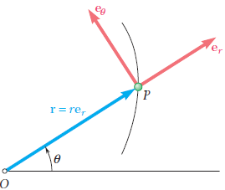
Radial and Transverse Components of Acceleration
In certain problems of plane motion, the position of the particle P is defined by its polar coordinates r and θ
Resolve the velocity and acceleration of the particle into components parallel and perpendicular, respectively, to the line OP.
These components are called radial and transverse components.

Slide 50



Slide 51
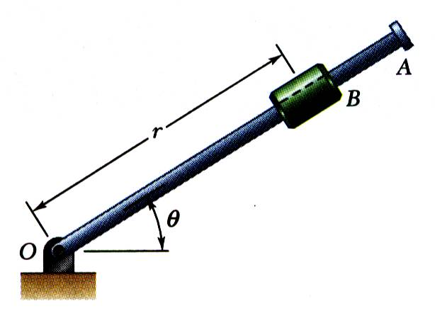
Sample Problem
Rotation of the arm about O is defined by θ = 0.15t² where θ is in radians and t in seconds. Collar B slides along the arm such that r = 0.9 - 0.12t² where r is in meters. After the arm has rotated through 30º, determine (a) the total velocity of the collar, (b) the total acceleration of the collar, and (c) the relative acceleration of the collar with respect to the arm.
SOLUTION:
Evaluate time t for θ = 30º.
Evaluate radial and angular positions, and first and second derivatives at time t.
Calculate velocity and acceleration in cylindrical coordinates.
Evaluate acceleration with respect to arm.

Slide 52
SOLUTION:
Evaluate time t for θ = 30º.
Evaluate radial and angular positions, and first and second derivatives at time t.

Slide 53
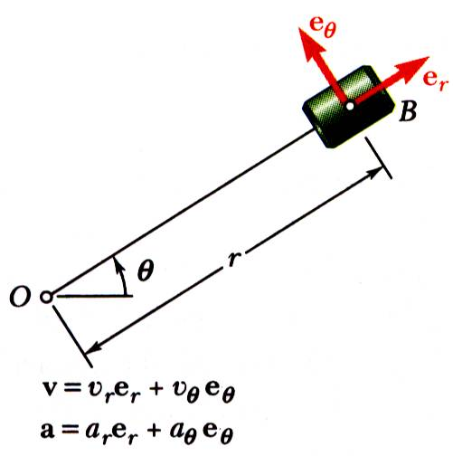
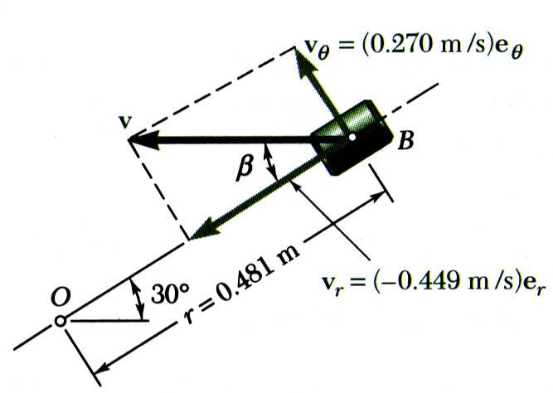
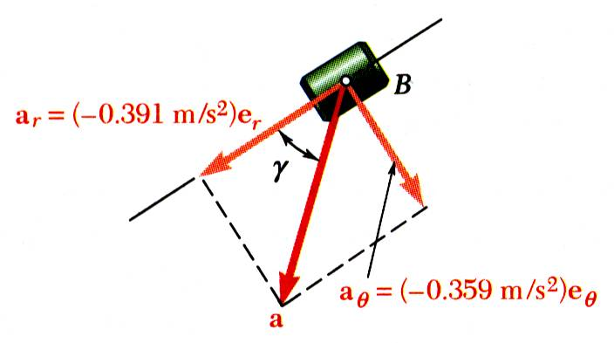
Calculate velocity and acceleration.

Slide 54

Evaluate acceleration with respect to arm.
Motion of collar with respect to arm is rectilinear and defined by coordinate r.

